Slide 1
Wellstone Conference
Saturday July 11th, 2020
Katie Laubscher, PT, DPT
Chyan Decker, BS
Notes:
*Katie talk
If you have attended our conference in person, you may be familiar with the panel at the end of the day. We also know that in coming together in person, many of you share ideas and learn from one another. This session – Life Hacks: Quarantine Edition – is our attempt to help bring input and perspective from some of you and help you share ideas with others in the audience.
I want to thank those of you who submitted pictures or videos – and a huge thank you to Chyan Decker for leading the task of gathering pictures and videos, uploading and preparing them into this presentation!

Slide 2
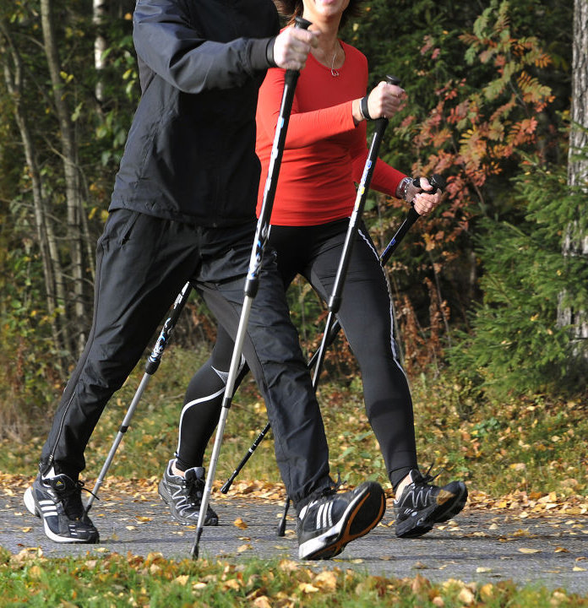
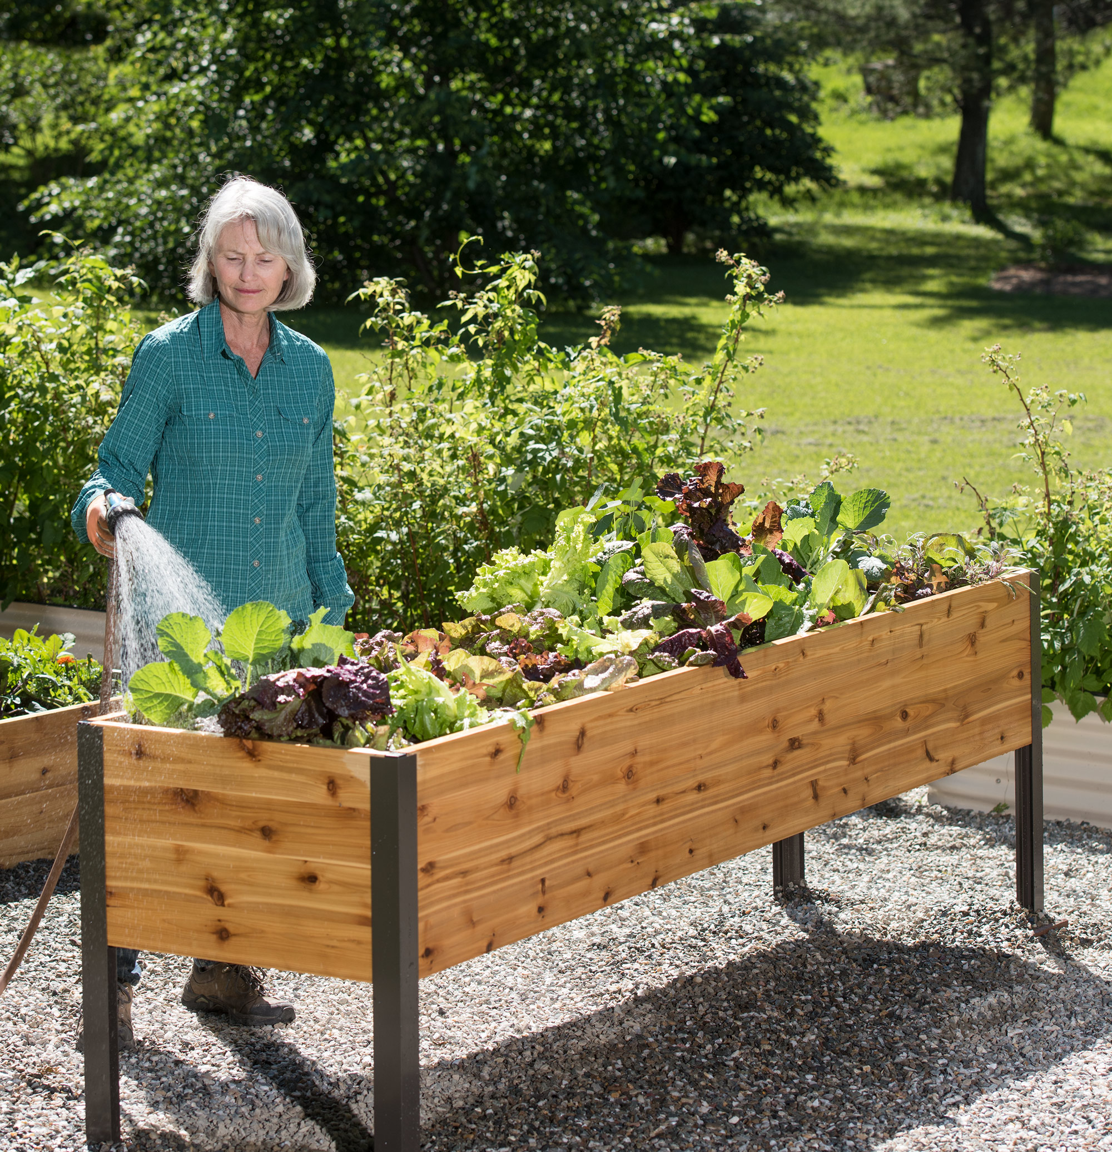
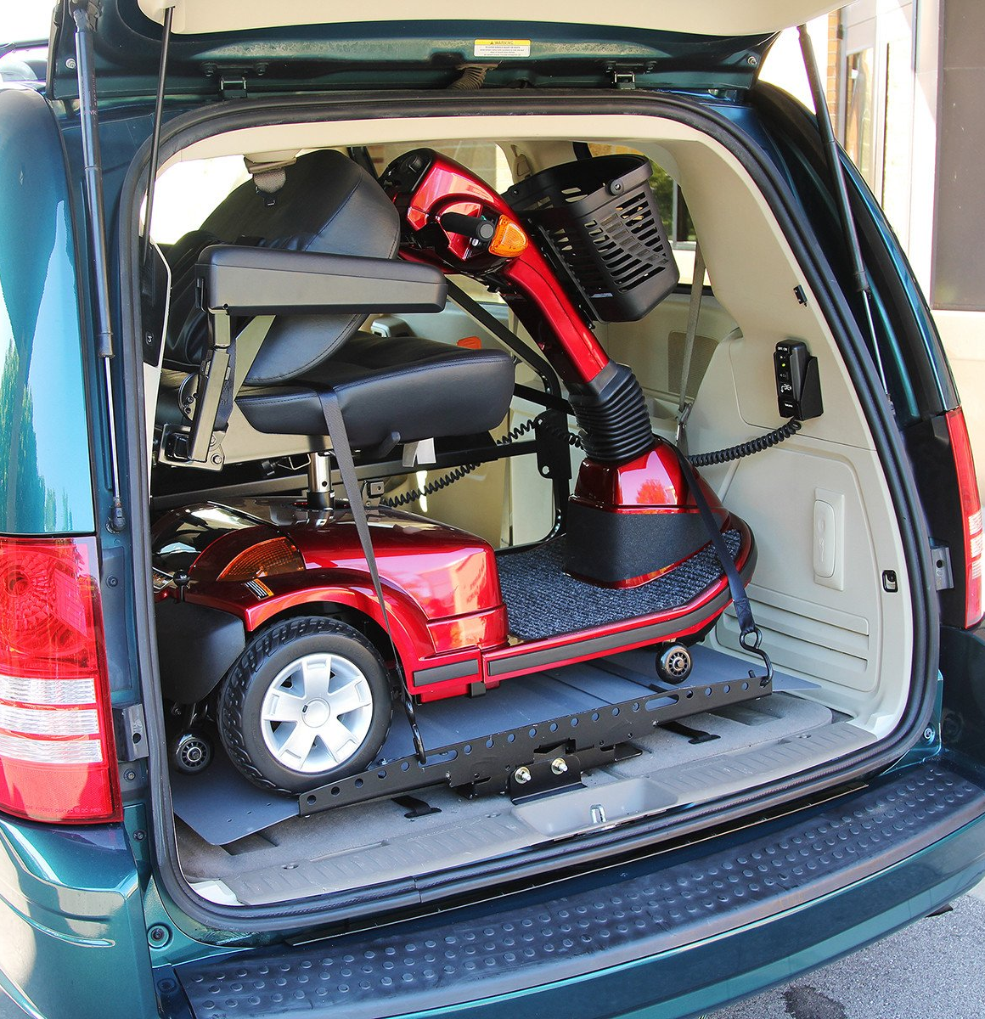
Category: Outdoor Activities
Notes:
*Katie – brief verbal transition

Slide 3
Hiking Sticks
Notes:
*Play video first, Katie talk after

Slide 4
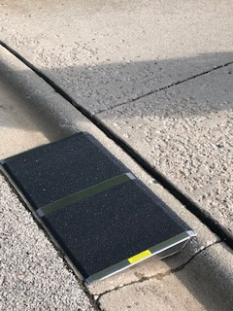
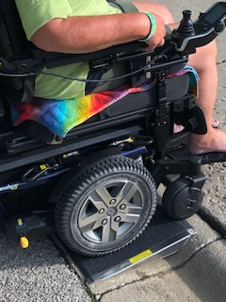
Portable Curb Ramp
“I use a 32 inch by 16 inch portable ramp to get up curbs or over door thresholds. Ramps come in all sizes at discountramps.com.”
-From Lisa
Notes:
* Katie will give an intro and then read Lisa’s quote.

Slide 5
Scooter and Van Lift
“I have a power elevating seat on my scooter so it will raise me to a standing position when I need to rise. When I chose my scooter almost 7 years ago, this seat rose the highest of any model. It’s been an awesome set up for me.”
-Julie
Notes:
*Katie will start with an intro, then play video and then Katie will read/summarize Julie’s quote

Slide 6
Accessible Gardening:
Notes:
* Play video first, Katie will add brief comment after

Slide 7
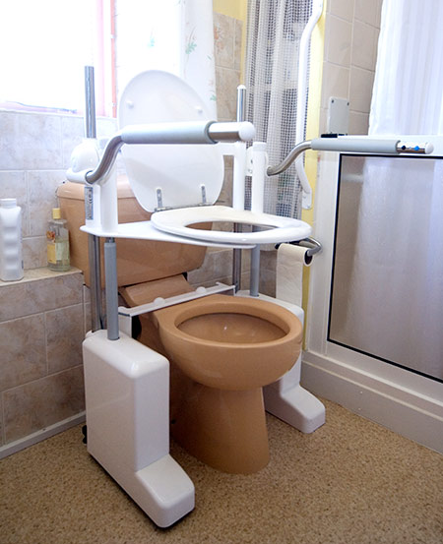
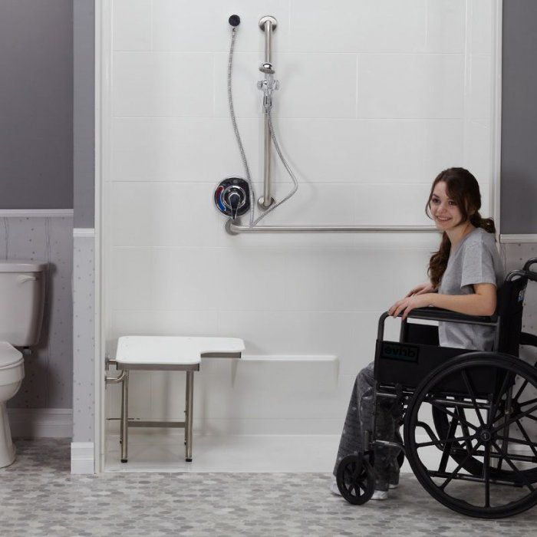
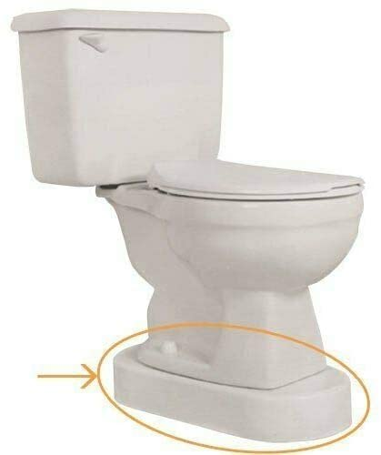
Category: Bathroom Modifications
Notes:
*Katie transition talking

Slide 8
Bathroom Accessibility:
Notes:
Play video first, Katie brief talking after

Slide 9
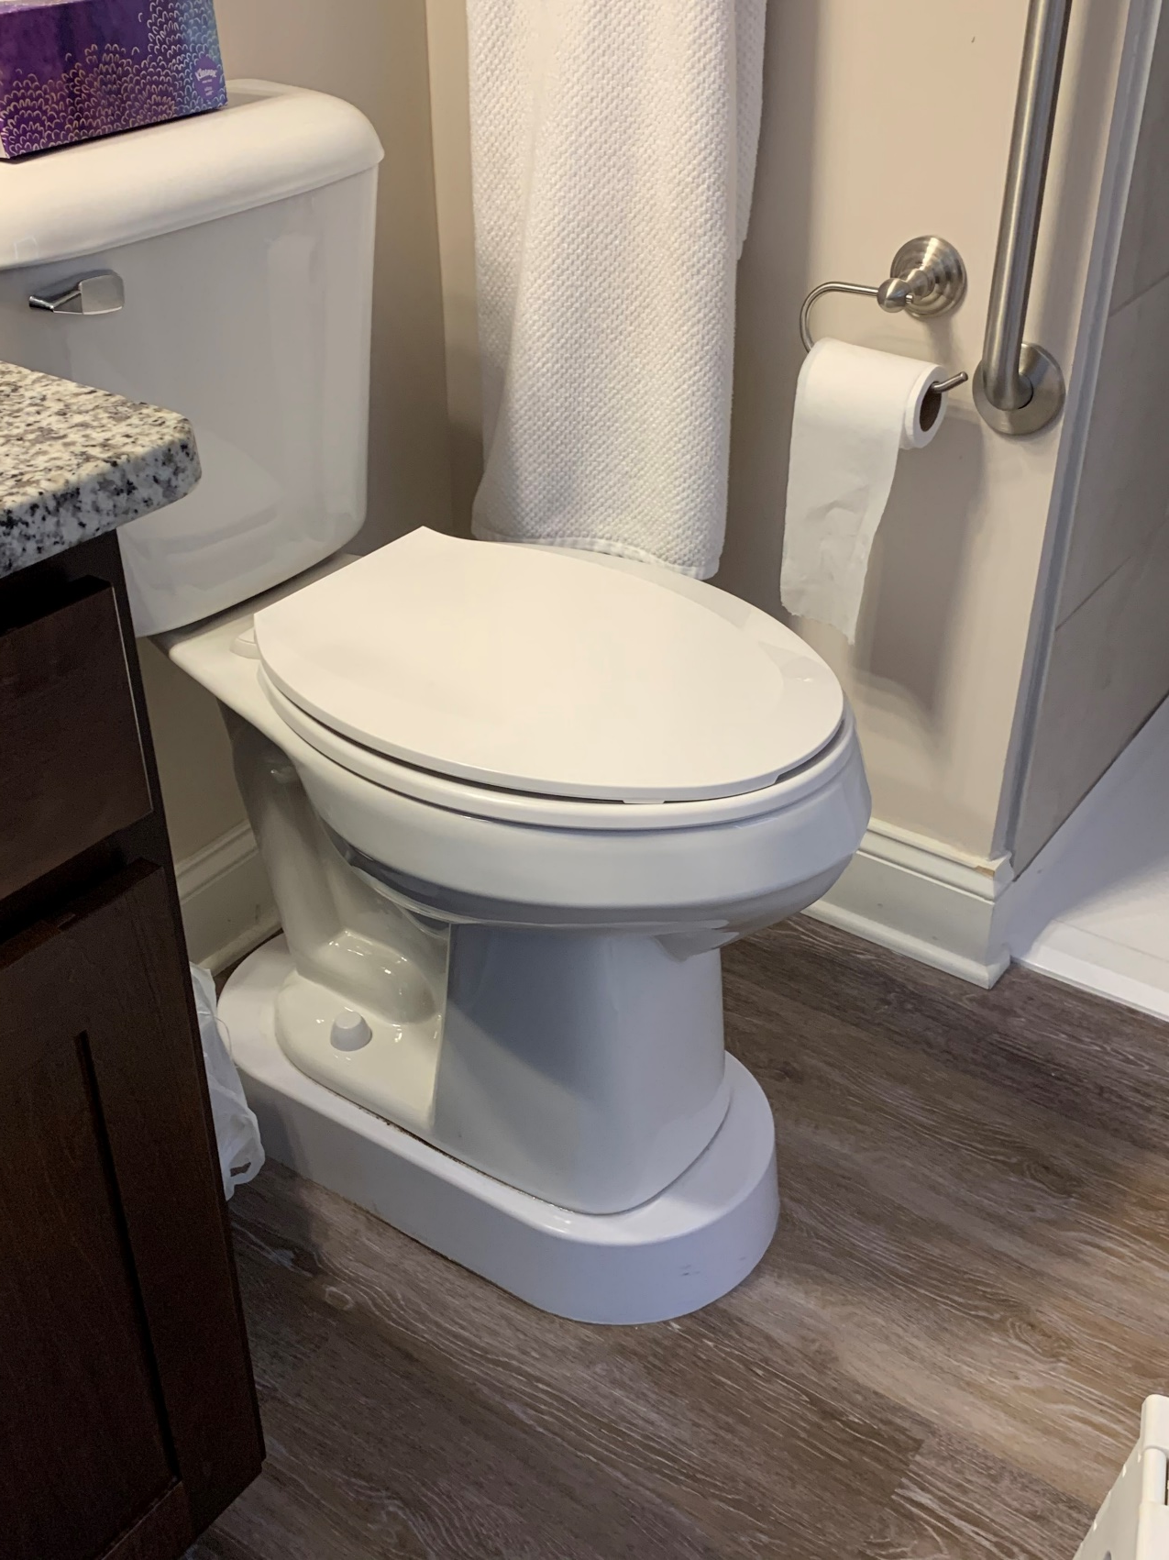
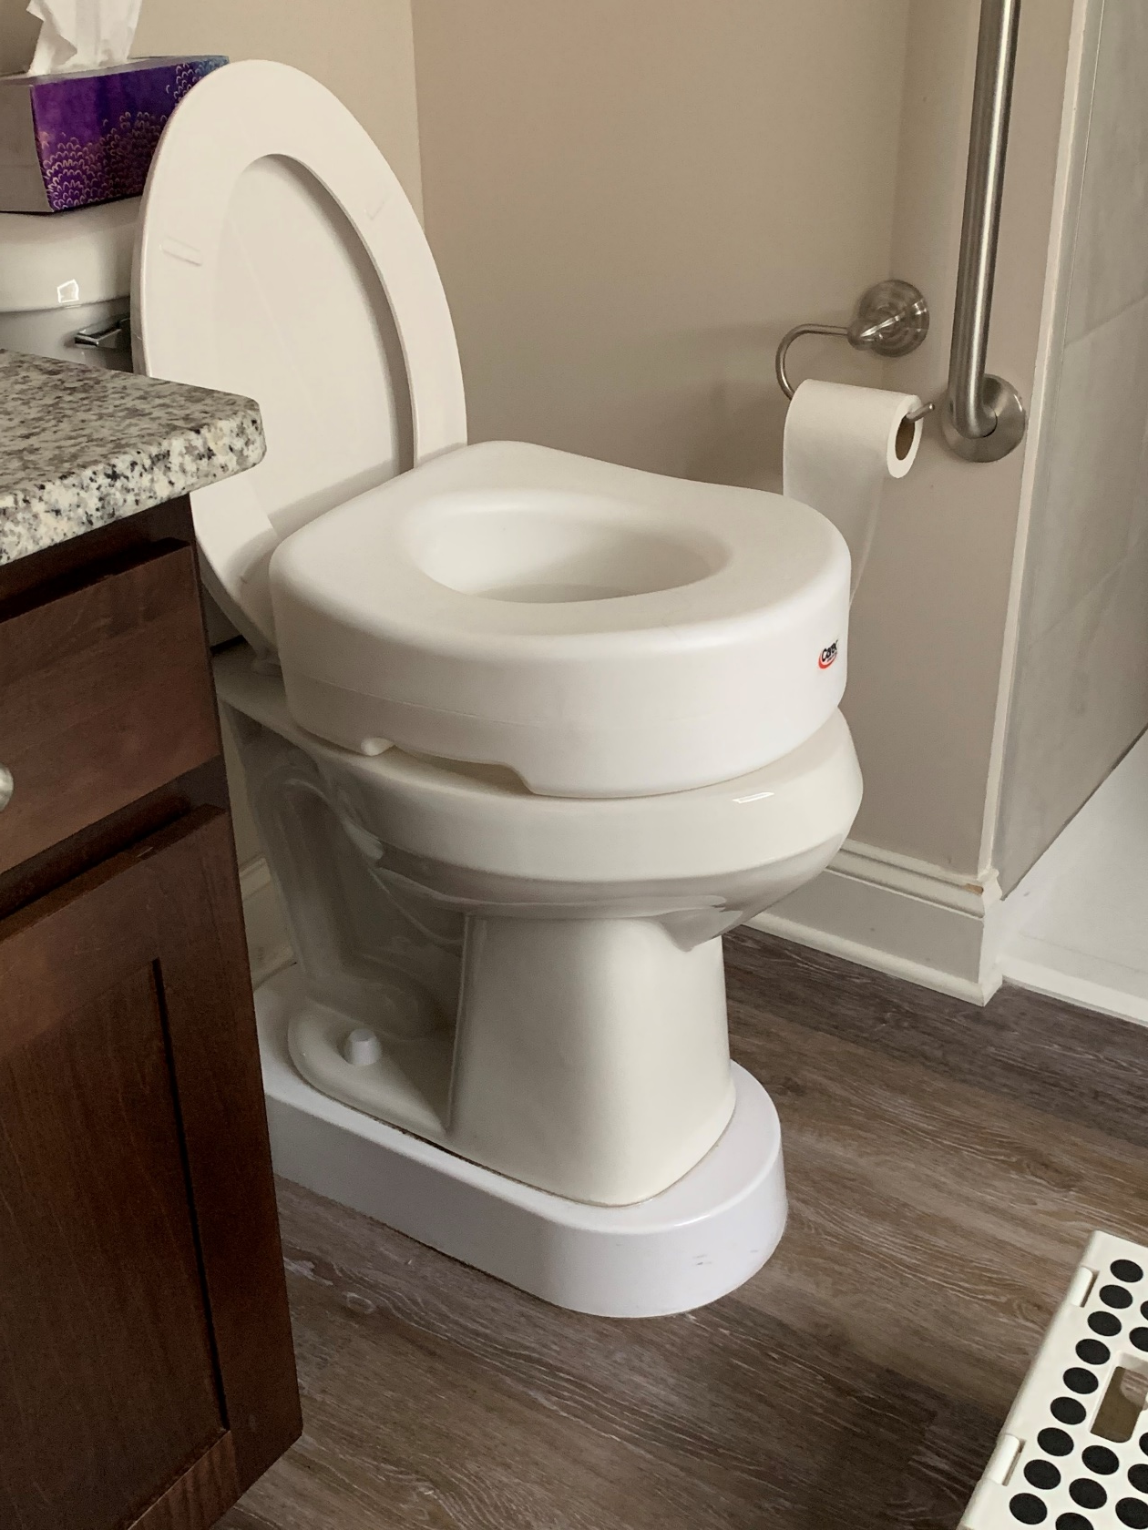
Toilet Modifications
“I have a Toilevator under the toilet to raise it 3.5 inches off the ground. If it’s not high enough, you can add an elevated toilet seat as well.”
-Andrea
Notes:
Katie to read quote

Slide 10
Toilet Lift
Notes:
Play video first, Katie to talk briefly after

Slide 11
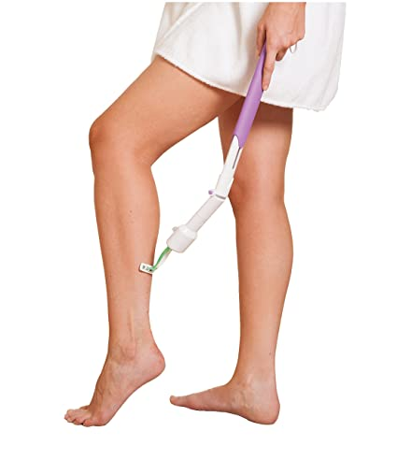
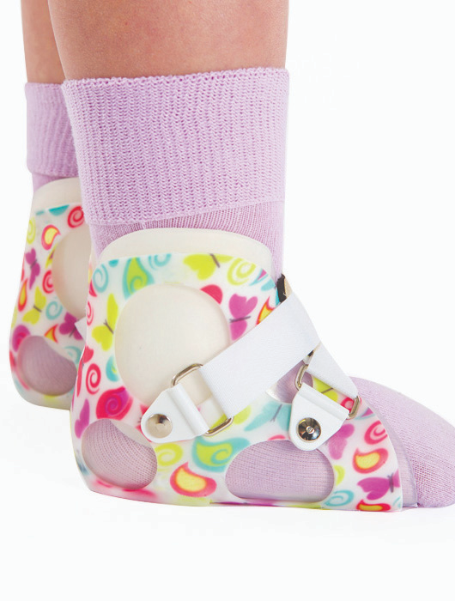
Category: Girl Hacks
Notes:
Katie short transition

Slide 12
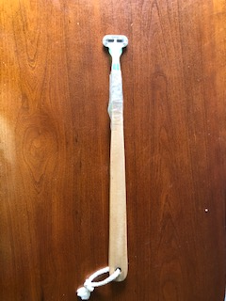
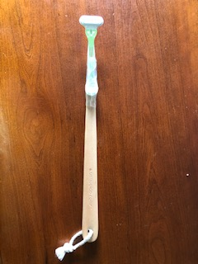
Razor Extension Hack
“I repurposed a shower sponge handle with a razor attached to it with clear packing tape. It helps me to be independent with personal care.”
-From Lisa
Notes:
Katie will read quote and small addition

Slide 13
Go Girl Pee Funnel
“The Go Girl is something that I always keep handy, in case I need to use the restroom when I’m away from home and the restroom isn’t accessible enough for me. It allows females to conveniently pee while standing. I used this for a year or two in my home before I had my toilet lift to save time and energy. Many females in the group have benefited from having these funnels, and several of my friends without MD also keep them in their hiking backpacks for convenience when they are hiking. I recommend practicing with them in the comfort of your home a few times to help feel confident using them when out.”
-From Julie
Notes:
Katie will give a small intro, then read Julie’s quote

Slide 14
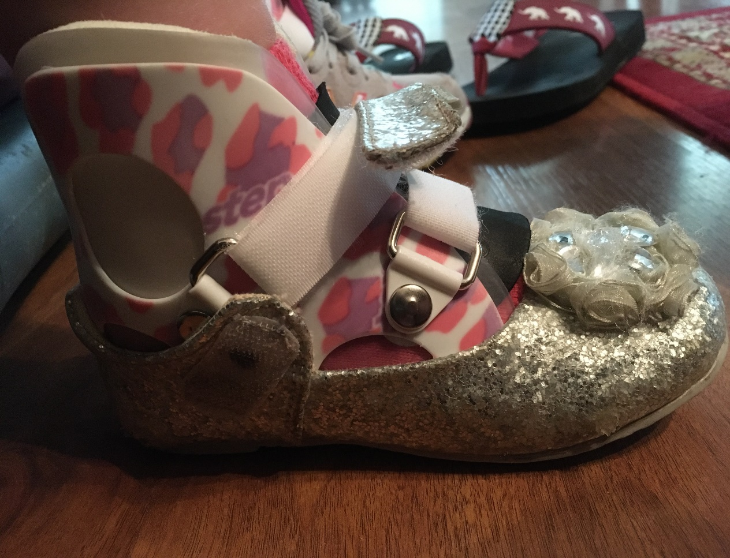
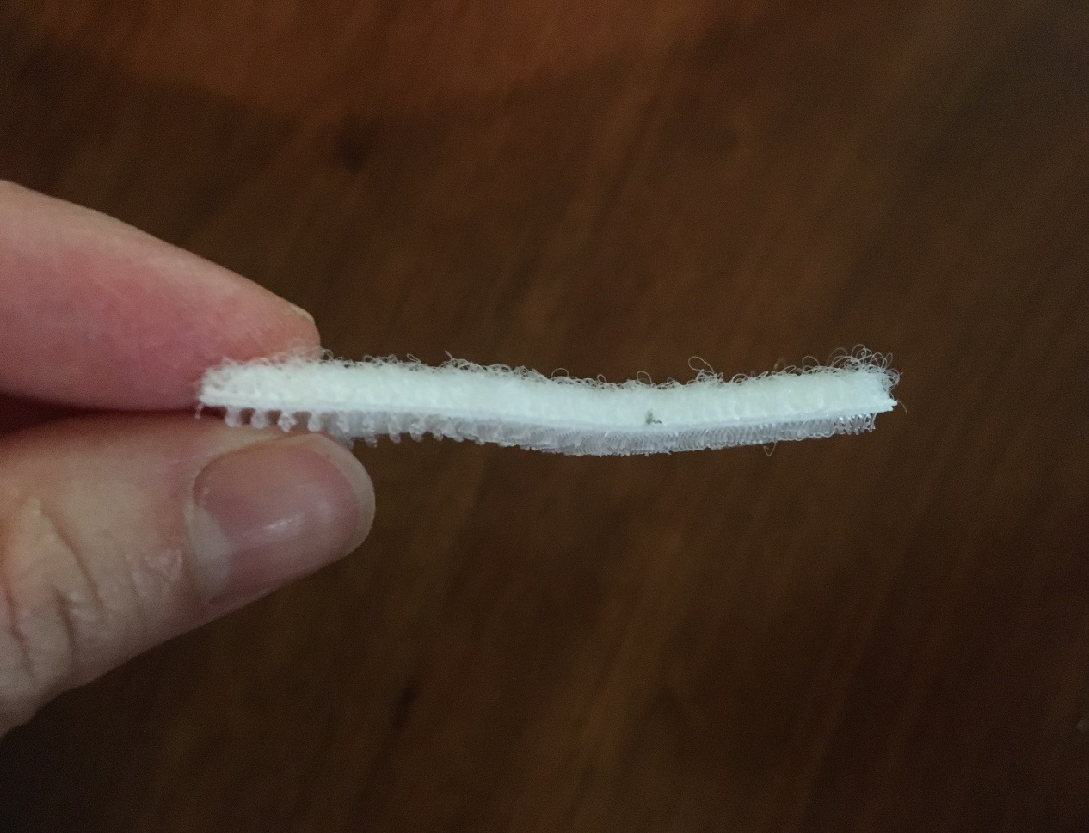
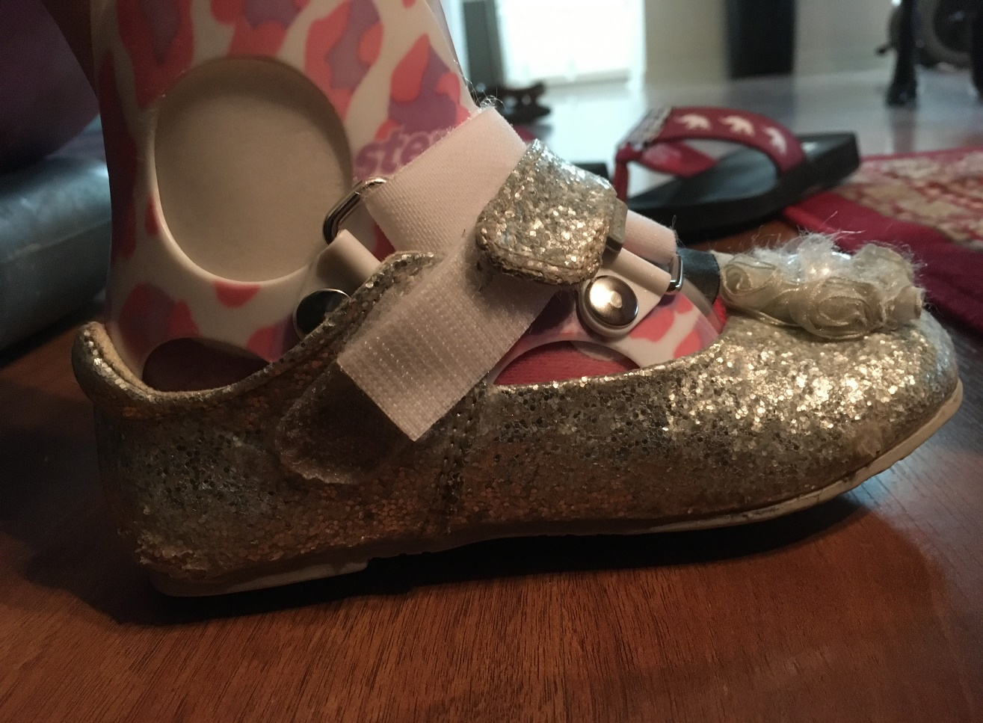
AFO/SMO Velcro Hack
“Here is a hack for wearing Velcro shoes over AFOs or SMOs that won’t fit all the way over the brace. This way girls who want to wear prettier shoes aren’t limited to tennis shoes only!
Take both sides of sticky backed Velcro strips cut to about an inch or so’s length. Push the sticky backs together and attach the Velcro to either side of the shoe’s Velcro to make it extend across the brace.”
-From Caroline, Mom of Kinsley
Notes:
Katie will give small intro, then read Caroline’s quote

Slide 15
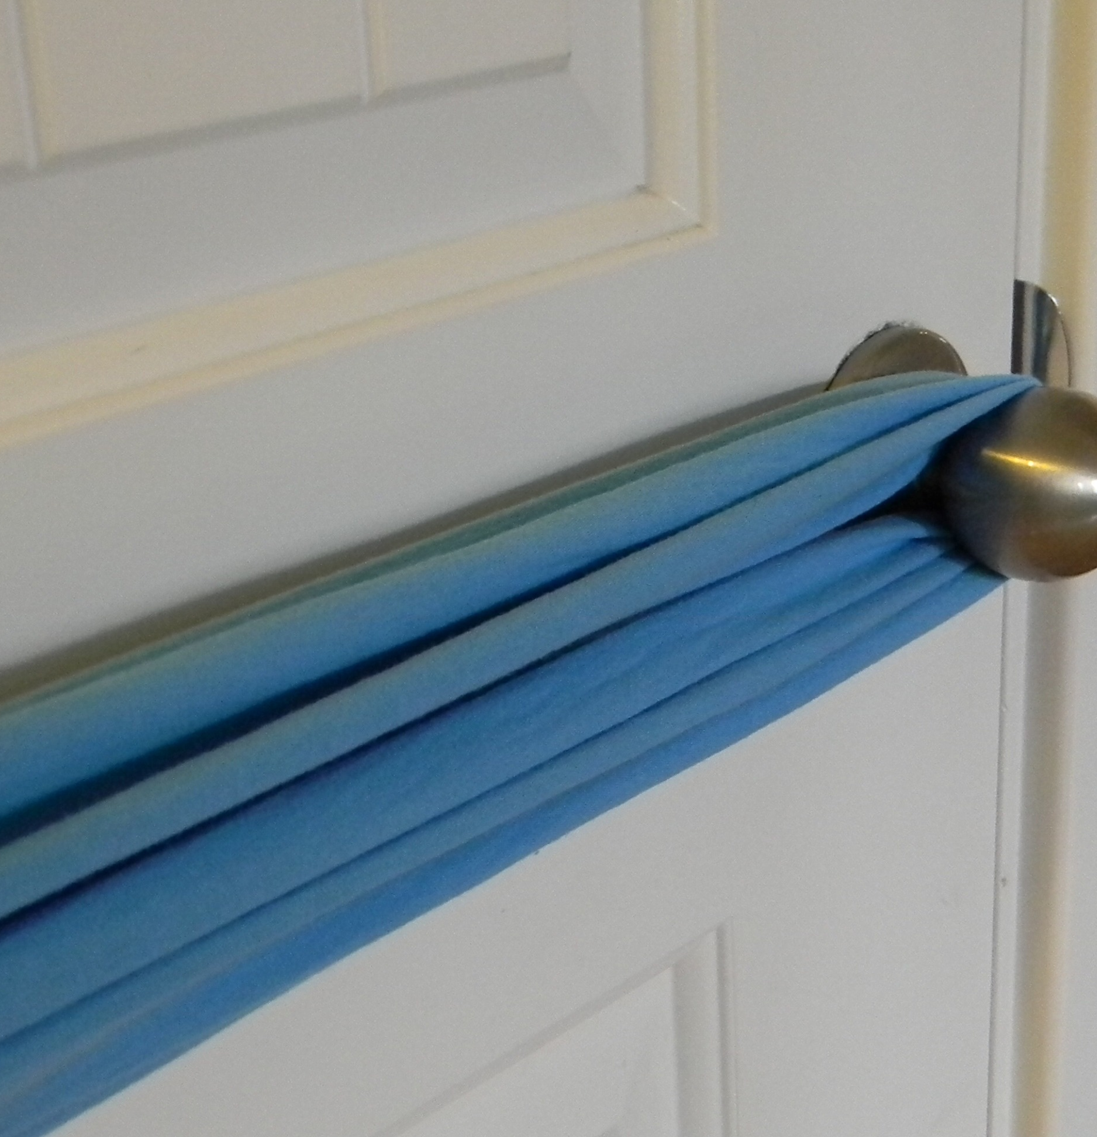
Moving Around the Home
Hacks by Andrea
Notes:
Katie – brief transition

Slide 16
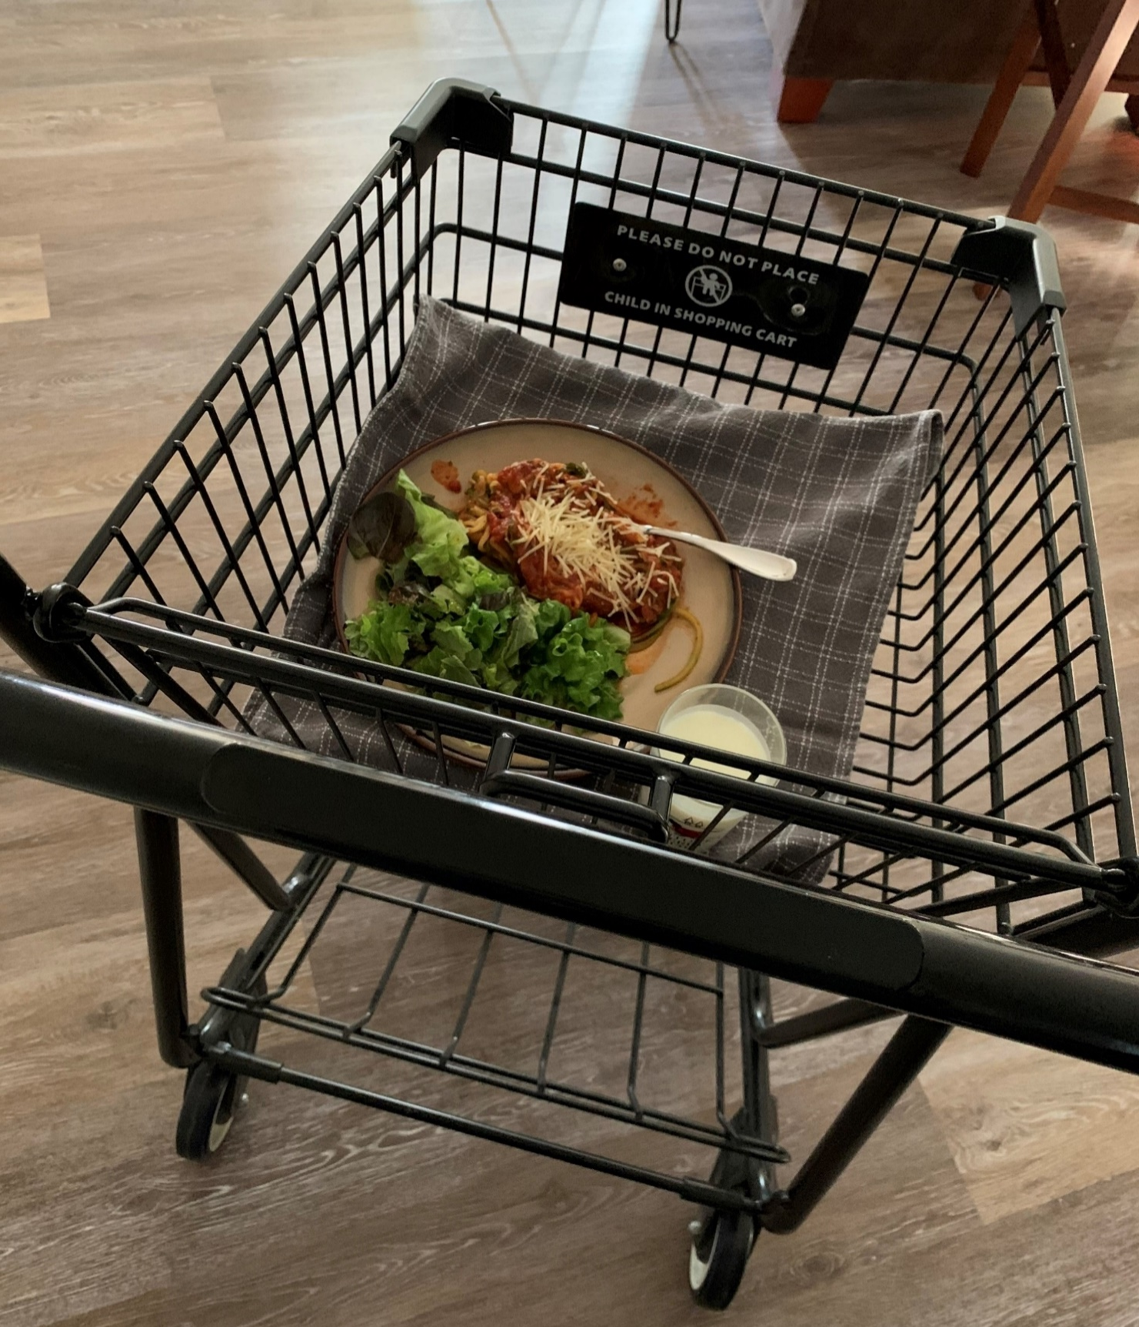
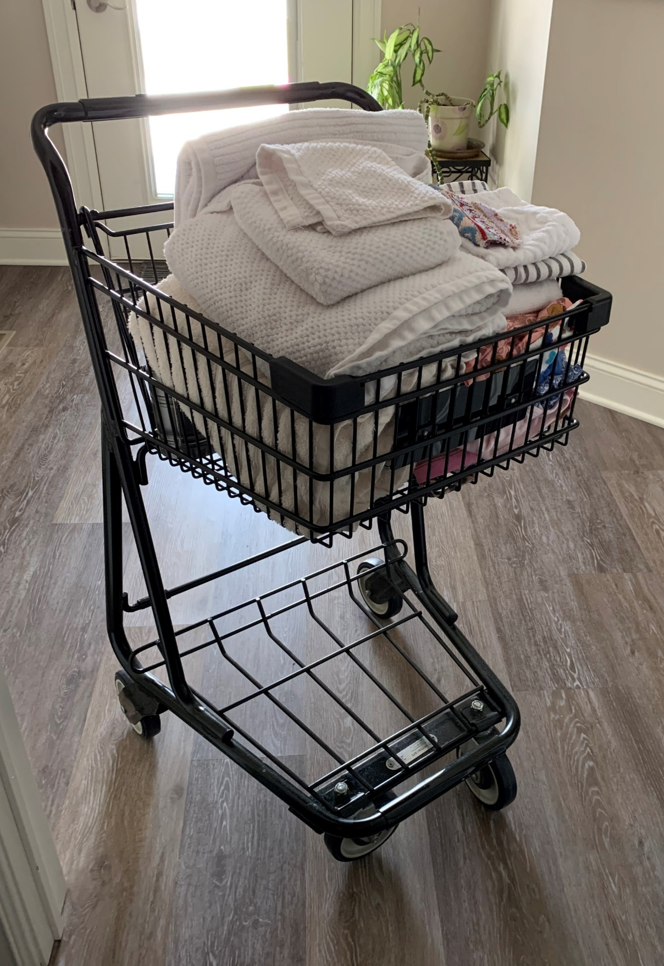
Shopping Cart Hack:
“This is a small shopping cart I bought at Staples probably 5 years ago. It was my best purchase!! It has definitely helped me continue to live independently. Initially I used it just for stability when walking around my apartment. It was sturdy, the bar was at the right height for me and it was heavier to push than a walker which I liked. Now, I use it for everything! It is super functional. I put literally everything in it from laundry, to groceries, to meals, to anything I need when going from point A to point B while walking, instead of using my wheelchair.”
-From Andrea

Slide 17
Scarf Hack
“I tied an old scarf around the door handle. When I’m closing it behind me, it is much easier to shut without my wheelchair getting in the way. You can really use anything as the pull. A small rope, long piece of fabric, a lanyard, or whatever you have really.”
-From Andrea
Notes:
Katie read quote first, then play video

Slide 18
Alexa/Google Home
“I have an amazon dot that I use to control my living room and bedroom lights. You just buy compatible smart plugs and use them to control lights, coffee makers or anything electronic that you want to. I only use it to turn my lights on when I get home or before going to bed. You can turn them off individually or program them as a group. It’s been really helpful.”
-From Andrea
Notes:
Read quote first, then play video

Slide 19
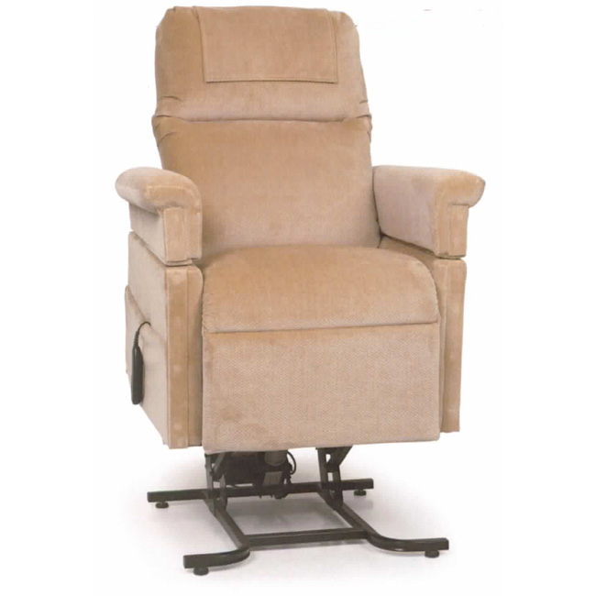
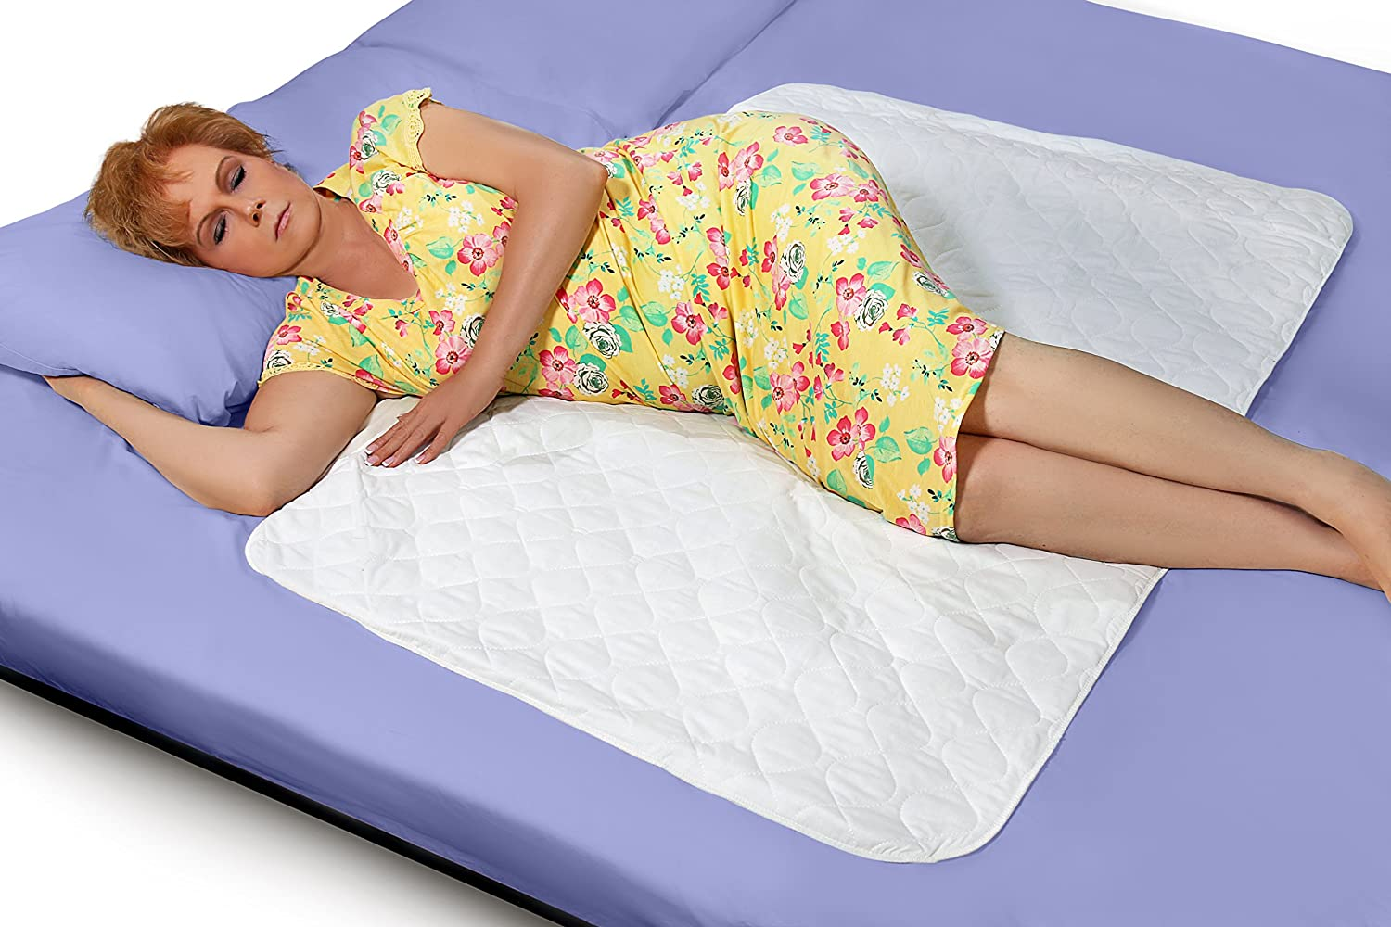
Comfort Hacks
Notes:
Katie – brief transition

Slide 20
Turning in Bed
Notes:
Play video first, Katie brief talk after

Slide 21
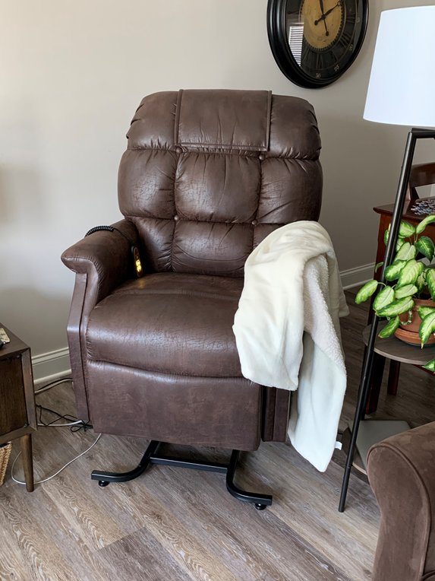
Recliner Lift
“My recliner lift chair is from Golden Technologies. They have various model and fabrics. You need to find the ones that can be switched to just a straight lift when rising instead of tilting you forward when rising.”
-Andrea
Notes:
Katie read quote first, then small addition

Slide 22
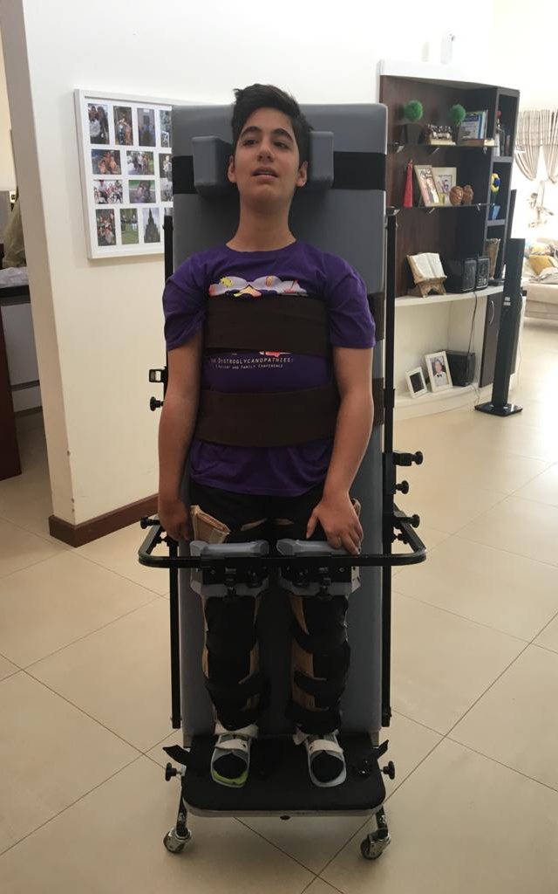
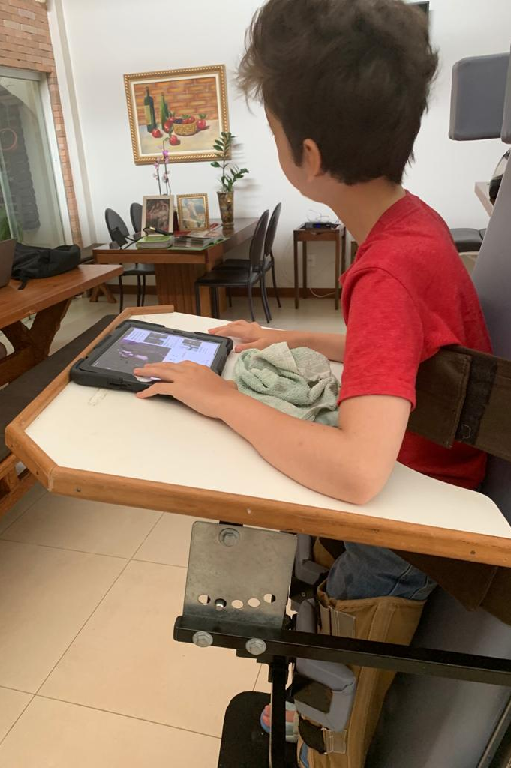
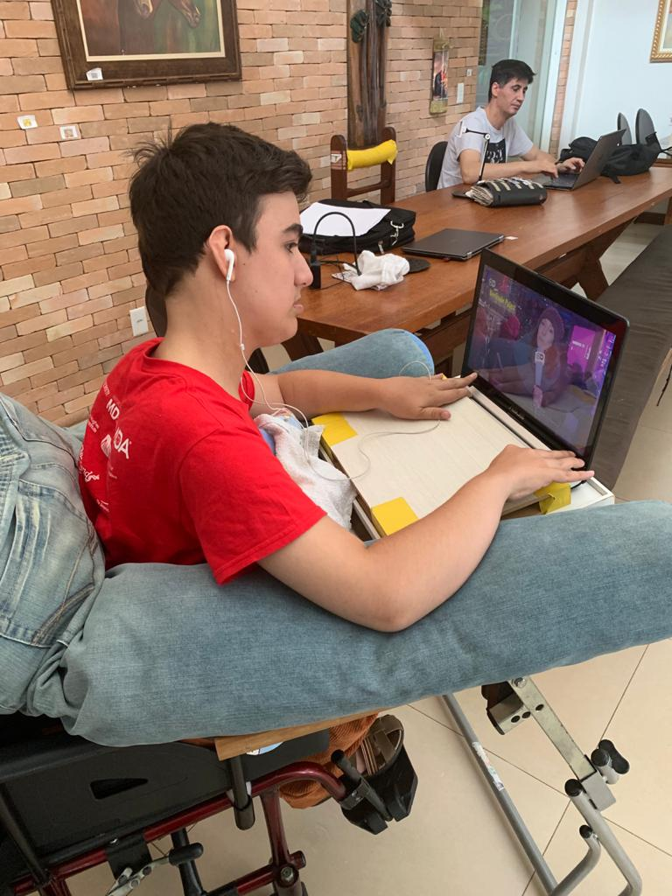
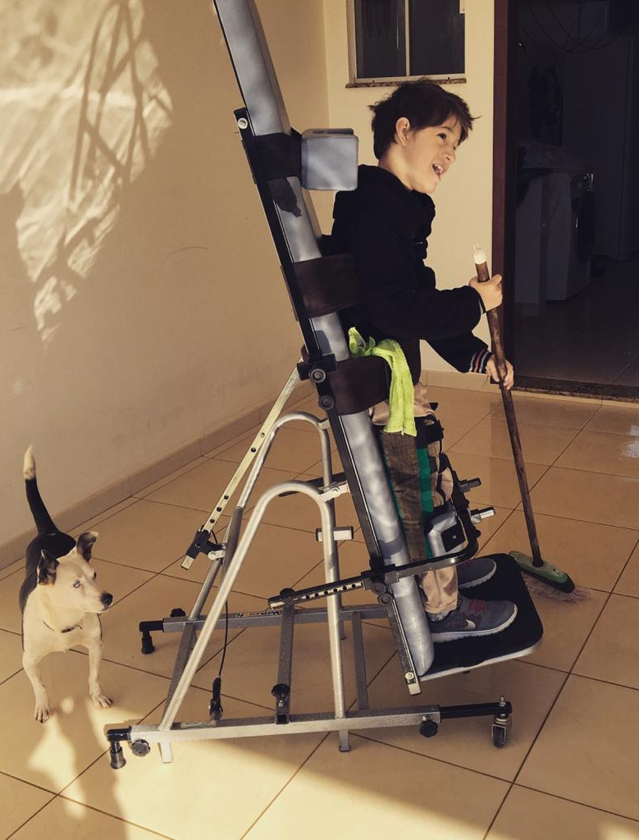
Congenital MD Hacks
Hacks by the Basso Family
Notes:
Katie – brief transition

Slide 23
Toilet Bar and Parapodium
Notes:
Start with video, Katie brief talking after

Slide 24
Pants Cushion and Communication Album
Notes:
Play video first, Katie brief talking after

Slide 25
Question & Answer time!
Submit your questions for Session 1 via the Q&A button.

